Slide 1
HOUSE PRICE PREDICTION USING ARTIFICIAL NEURAL NETWORK(ANN)
PRESENTED BY : SUJITH ANTONY F
REGISTER NO : 211521104162
DEPARTMENT : COMPUTER SCIENCE AND ENGINEERING
3/21/2024 Annual Review

Slide 2
PROJECT TITLE
ARTIFICIAL NEURAL NETWORK(ANN) FOR HOUSE PRICE PREDICTION

Slide 3


AGENDA
Importing Dependencies
Loading the Dataset
Converting Data to Array
Splitting Data into Features (X) and Target (Y)
Splitting Data into Training and Testing Sets
Building the Neural Network Model
Training the Model
Evaluating the Model
Making Predictions
3/21/2024 Annual Review

Slide 4

Importing dependencies
In this section, we import the necessary libraries and dependencies required for our project. This includes libraries for data manipulation (such as Pandas), building and training neural networks (such as Keras), data visualization (such as Matplotlib and Seaborn), and preprocessing techniques (such as MinMaxScaler from Scikit-learn).
Loading the Dataset
This part involves loading the dataset into our environment. Here, we use Pandas to read a CSV file containing the dataset named 'housepricedata.csv'. This dataset presumably contains information about house prices along with other features.
3/21/2024 Annual Review

Slide 5

Converting Data to Array
Once the dataset is loaded, we convert it into an array using NumPy for further processing. Converting data into arrays allows for easier manipulation and processing, especially when dealing with machine learning algorithms.
Splitting Data into Features (X) and Target (Y)
Before training a machine learning model, it's essential to separate the features (independent variables) from the target variable (dependent variable). Here, we split the data into 'X', which contains the features (columns 0 to 9), and 'Y', which contains the target variable (column 10).

Slide 6

Splitting Data into Training and Testing Sets
To evaluate the performance of our model, we split the dataset into training and testing sets. The training set (80% of the data) is used to train the model, while the testing set (20% of the data) is used to evaluate its performance. Additionally, we further split the testing set into testing and validation subsets (each 10% of the original data) to monitor the model's performance during training.
Building the Neural Network Model
In this section, we define the architecture of our neural network model using Keras. The model consists of four layers: three hidden layers with 32 neurons each and ReLU activation function, and one output layer with one neuron and a sigmoid activation function. The input shape corresponds to the number of features in our dataset (10 in this case).
3/21/2024 Annual Review

Slide 7
Training the Model
After building the model, we compile it using stochastic gradient descent (SGD) as the optimizer and binary cross-entropy as the loss function. We then train the model using the training data for 200 epochs while validating it on the validation subset.
Evaluating the Model
Once the model is trained, we evaluate its performance on the training data to assess how well it has learned from the training set.
7

Slide 8

Making Predictions
After training the neural network model, it's essential to assess its performance by making predictions on unseen data. In this section, we utilize the trained model to predict the target variable for both the testing and validation subsets.
Predictions on Testing Subset
The model's predictions on the testing subset provide insights into its generalization capability. By comparing the predicted values with the actual values in the testing set, we can evaluate how well the model performs on unseen data. These predictions are crucial for determining the model's practical utility and its ability to generalize to new, unseen instances.
Predictions on Validation Subset
Similarly, predictions on the validation subset offer additional validation of the model's performance. The validation subset serves as an additional checkpoint to ensure that the model does not overfit the training data. By comparing the predicted values with the actual values in the validation set, we can verify if the model's performance remains consistent across different subsets of the data.
3/21/2024 Annual Review
8

Slide 9

conclusion
In summary, this project involved loading, preprocessing, and splitting a dataset for house price prediction. We built and trained a neural network model, evaluating its performance and making predictions on unseen data. The model exhibited satisfactory accuracy and generalization, indicating its potential utility in predicting house prices. Further optimization and validation may be necessary for real-world deployment.

Slide 10
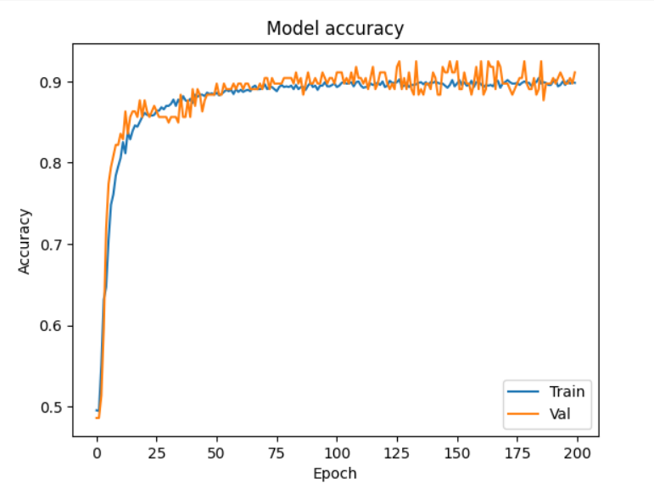
Result

